Slide 1
Cloud Computing
CSI ZG527 / SS ZG527 / SE ZG527
Module 3
Infrastructure as a Service

Slide 2


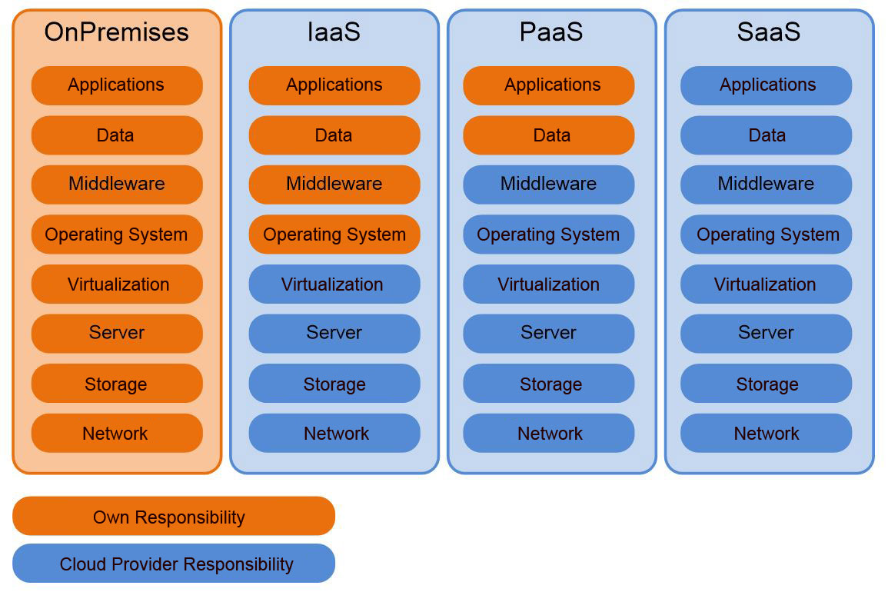
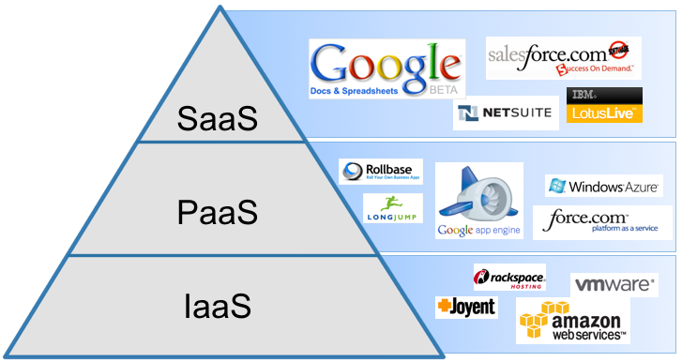
heard of 3 models of Cloud Computing?
Yes, Yes, IaaS, PaaS and SaaS

Slide 3
Infrastructure as a Service (IaaS)
Under the IaaS cloud computing model, cloud service providers make computing and storage resources (such as servers and storage) available as a service.
This offers maximum flexibility for users to work with the cloud infrastructure, wherein exactly how the virtual computing and storage resources are used is left to the cloud user.

Slide 4
Features of IaaS
Geographic Presence
User Interfaces and Access to Servers
Advance Reservation of Capacity
Automatic Scaling and Load Balancing
Automatic Scaling and Load Balancing
Service-Level Agreement (SLA)
Hypervisor and Operating System Choice

Slide 5
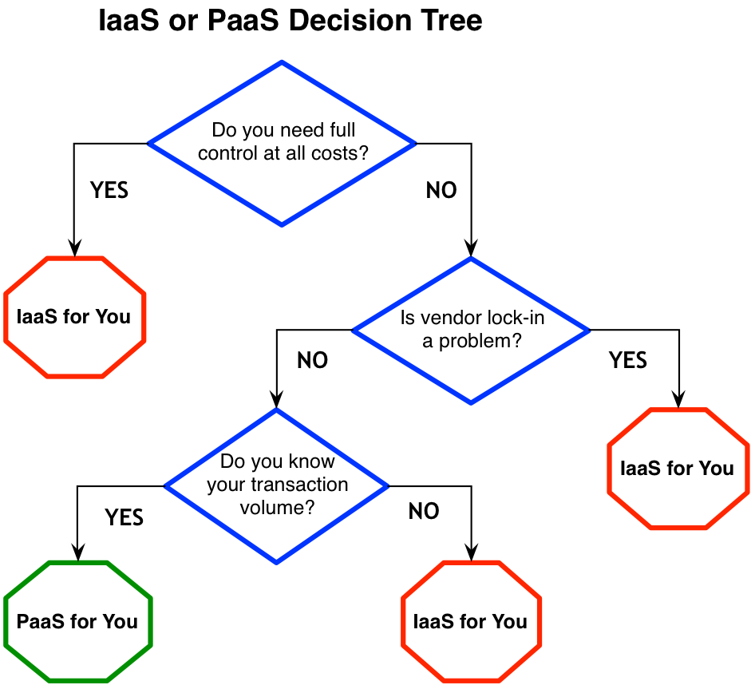

Slide 6
The value of IaaS
For businesses, the greatest value of IaaS is through a concept known as cloudbursting—the process of off-loading tasks to the cloud during times when the most compute resources are needed.
To take advantage of IaaS in this capacity, IT departments must be able to build and implement the software that handles the ability to re-allocate processes to an IaaS cloud.
There are four important considerations to build and implement software that can manage such reallocation processes.

Slide 7
4 considerations:
Developing for a specific vendor's proprietary IaaS could prove to be a costly mistake.
The complexity of well-written resource allocation software is significant and do not come cheap
What will you be sending off to be processed in the cloud? Sending data such as personal identities, financial information, and health care data put an organization's compliance at risk
Understand the dangers of shipping off processes that are critical to the day-to-day operation of the business.
http://www.ibm.com/developerworks/cloud/library/cl-cloudservices1iaas/

Slide 8
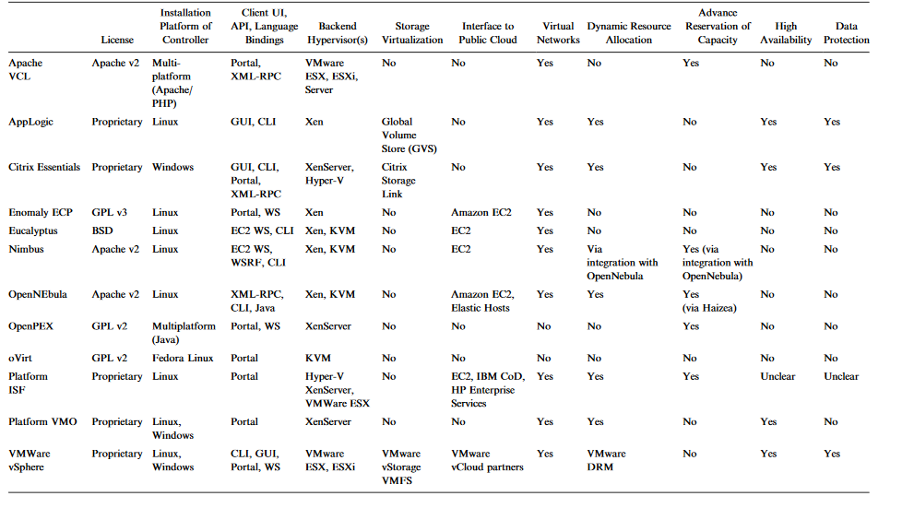
Feature Comparison of Virtual Infrastructure Managers

Slide 9
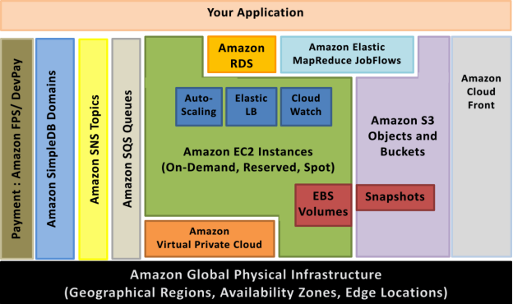
AWS infrastructure services

Slide 10
Amazon Web Services (AWS)
IaaS that AWS offer:
Storage as a Service
- Amazon Simple Storage Service
- Amazon SimpleDB
- Amazon Relational Database Service
Compute as a Service
- Amazon Elastic Compute Cloud (EC2)
Notes:
RL 3.2

Slide 11
Different types of Data
Enterprises have varied requirements for data, including structured data in relational databases that power an e-commerce business, or documents that capture unstructured data about business processes, plans and visions.
Enterprises may also need to store objects on behalf of their customers, like an online photo album or a collaborative document editing platform.
Further, some of the data may be confidential and must be protected, while
others data should be easily shareable.
In all cases, business critical data should be secure and available on demand in the face of hardware and software failures, network partitions and inevitable user errors.

Slide 12
Storage as a Service: Amazon Storage Services
Simple Storage Service (S3): An object store
SimpleDB: A Key-value store
Relational Database Service (RDS): MySQL instance
and so on.

Slide 13
Amazon’s Simple Storage Server (S3)
Amazon S3 is a highly reliable, highly available, scalable and fast storage in the cloud for storing and retrieving large amounts of data just through simple web services.
S3 is a storage service, several S3 browsers exist that allow users to explore their S3 account as if it were a directory (or a folder). There are also file system implementations that let users treat their S3 account as just another directory on their local disk.
S3 Access Methods:
• AWS Console
• Amazon’s RESTful API
• SDKs for Ruby and other languages

Slide 14
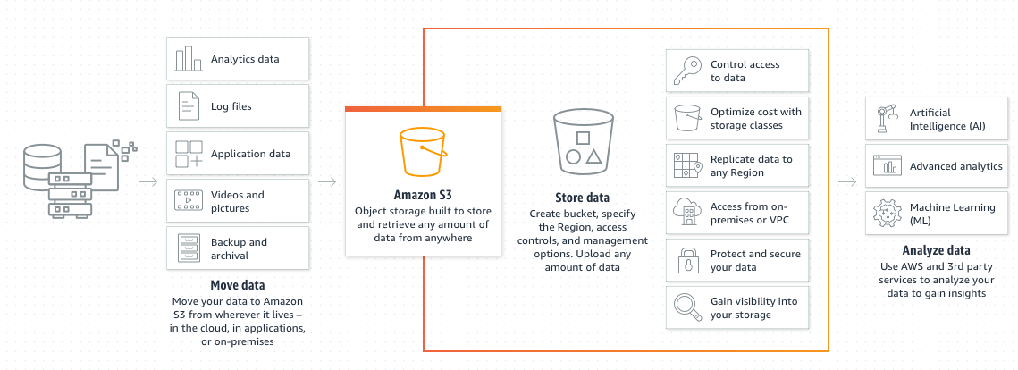
Amazon S3: How it works?.
Ref: https://aws.amazon.com/s3/

Slide 15
Organizing Data In S3: Buckets, Objects and Keys
Files are called objects in S3.
Objects are referred to with keys – basically an optional directory path name followed by the name of the object.
Objects in S3 are replicated across multiple geographic locations to make it resilient to several types of failures (however, consistency across replicas is not guaranteed).
If object versioning is enabled, recovery from inadvertent deletions and modifications is possible.
S3 objects can be up to 5 Terabytes in size and there are no limits on the number of objects that can be stored.
All objects in S3 must be stored in a bucket.

Slide 16
Organizing Data In S3: Buckets, Objects and Keys (Cont…)
Buckets provide a way to keep related objects in one place and separate
them from others. There can be up to 100 buckets per account and an unlimited number of objects in a bucket.

Slide 17
S3 objects
Each object has a key, which can be used as the path to the resource in an HTTP URL.
For example, if the bucket is named johndoe and the key to an object is
resume.doc, then its HTTP URL is http://s3.amazonaws.com/johndoe/resume.doc
or alternatively, http://johndoe.s3.amazonaws.com/resume.doc
URL needs authentication parameters; S3 objects are private by default
and requests should carry authentication parameters that prove the requester has rights to access the object, unless the object has “Public” permissions.
Note: The bucket namespace is shared; i.e., it is not possible to create a bucket with a name that has already been used by another S3 user.

Slide 18
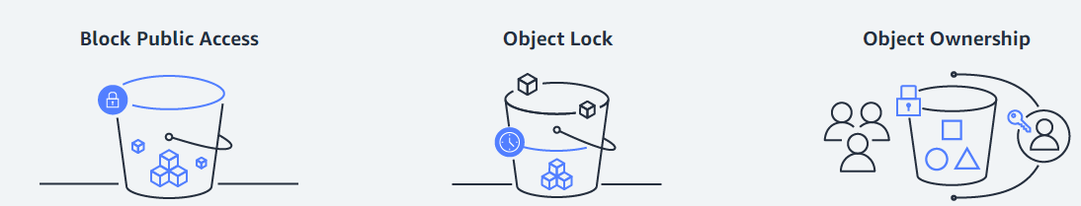
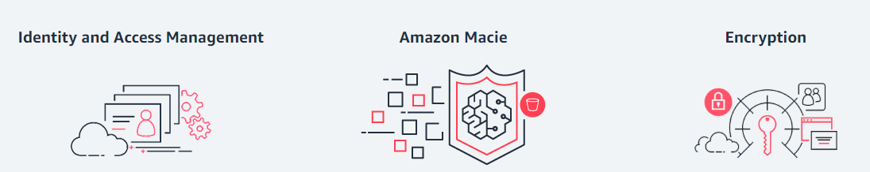
Amazon S3 security and access management

Slide 19
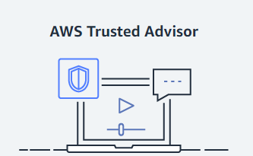
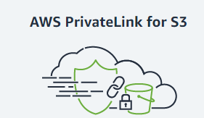
Amazon S3 security and access management

Slide 20
Large Objects and Multi-part Uploads on S3
The object size limit for S3 is 5 terabytes.
If this limit is not sufficient, the object then can be stored in smaller chunks with the splitting and re-composition being managed in the application, using the data.
Note: Uploading large objects on Amazon S3 will still take some time even though it has high aggregate bandwidth available. Additionally, if an upload fails, the entire object needs to be uploaded again.
Multi-part upload solves both the above problems elegantly.
S3 provides APIs that allow the developer to write a program that splits a large object into several parts and uploads each part independently.
These uploads can be parallelized for greater speed to maximize the network utilization.
If a part fails to upload, only that part needs to be re-tried.

Slide 21
Simple use-case with S3 (Uploading photos)
Sign up for S3 at http://aws.amazon.com/s3/. While signing up, obtain the
AWS Access Key and the AWS Secret Key. These are similar to userid and password that is used to authenticate all transactions with Amazon Web
Services (not just S3).
2. Sign in to the AWS Management Console for S3 at the below URL
https://console.aws.amazon.com/s3/home
3. Create a bucket giving a name and geographical location where it can be stored. In S3 all files (called objects) are stored in a bucket, which represents a collection of related objects.
4. Click the Upload button and follow the instructions to upload files.
5. The photos or other files are now safely backed up to S3 and available for sharing with a URL if the right permissions are provided.
Note: From a developer perspective, this can also be accomplished programmatically.

Slide 22
Amazon Simple Database Service (SimpleDB)
SimpleDB (SDB) provides a simple data store interface in the form of a key-value store.
It allows storage and retrieval of a set of attributes based on a key.
It is a highly available, flexible, and scalable non-relational data store that offloads the work of database administration. It provides the core database functions of data indexing and querying in the cloud.
It provides a simple web services interface to create and store multiple data sets, query your data easily, and return the results.

Slide 23
Data Organization and Access in SimpleDB
Data is organized into domains.
Each item in a domain has a unique key that must be provided during creation.
Each item can have up to 256 attributes, which are name-value pairs.
SDB provides a query language that is analogous to SQL, although there are
methods to fetch a single item.
Queries take advantage of the fact that SDB automatically indexes all attributes.

Slide 24
Availability and Administration in SimpleDB
SDB has a number of features to increase availability and reliability.
Data stored in SDB is automatically replicated across different geographies for high availability.
It also automatically adds compute resources in proportion to the request rate and automatically indexes all fields in the dataset for efficient access.
SDB is schema-less; i.e., fields can be added to the dataset as the need arises.

Slide 25
Amazon Relational Database Service (RDS)
RDS provides a traditional database abstraction in the cloud, specifically a MySQL instance in the cloud.
An RDS instance can be created using the RDS tab in the AWS Management Console as shown in the next slide.
AWS performs many of the administrative tasks associated with maintaining
a database for the user.
The database is backed up at configurable intervals, which can be as frequent as 5 minutes.
The backup data are retained for a configurable period of time which can be up to 8 days. Amazon also provides the capability to snapshot the database as needed.

Slide 26
COMPUTE AS A SERVICE: AMAZON ELASTIC COMPUTE
CLOUD (EC2)
Compute as a Service:
Here, computing resources are offered as a service to the users.
It should be possible to associate storage with the computing service (so that the results of the computation can be made persistent).
Virtual networking is needed as well, so that it is possible to communicate with the computing instance.
All these together make up Infrastructure as a Service.
Note: Amazon’s Elastic Compute Cloud (EC2) is one of the popular Compute as a Service offerings

Slide 27
EC2 Computational Resources
Computing Resources:
The computing resources available on EC2, referred to as EC2 instances, consist of combinations of computing power, together with other resources such as memory.
Amazon measures the computing power of an EC2 instance in terms of EC2 Compute Units.
An EC2 Compute Unit (CU) is a standard measure of computing power in the same way that bytes are a standard measure of storage.
One EC2 CU provides the same amount of computing power as a 1.0–1.2 GHz Opteron or Xeon processor in 2007
For example, if a developer requests a computing resource of 1 EC2 CU, and the resource is allocated on a2.4 GHz processor, they may get 50% of the CPU. This allows developers to request standard amounts of CPU power regardless of the physical hardware.

Slide 28
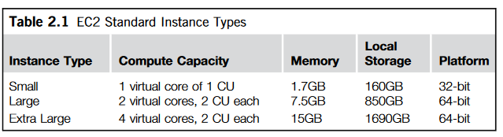
Instance Types in EC2
A developer can request a computing resource of one of the instance types shown in the table.
Note: High memory instances are also available for databases and other memory-hungry applications

Slide 29
EC2 Softwares
Amazon makes available operating system and application software in the form of Amazon Machine Images(AMIs).
Operating systems available in AMIs include various flavors of Linux, such as Red Hat Enterprise Linux and SuSE, the Windows server, and Solaris.
The required AMI has to be specified when requesting the EC2 instance, as demonstrated. The AMI running on an EC2 instance is also called the root AMI.
Software available includes databases such as IBM DB2, Oracle and Microsoft SQL Server. A wide variety of other application software and middleware, such as Hadoop, Apache, and Ruby on Rails, are also available.

Slide 30
Accessing additional softwares on EC2
There are two ways of using additional software not available in standard AMIs.
Request a standard AMI, and then install the additional software needed. This AMI can then be saved as one of the available AMIs in Amazon.
Import a VMware image as an AMI using the ec2-import-instance and
ec2-import-disk-image commands

Slide 31
Regions and Availability Zones of EC2
EC2 offers regions, which are the same as the S3 regions described in the earlier slides of S3.
Within a region, there are multiple availability zones, where each availability zone corresponds to a virtual data center that is isolated (for failure purposes) from other availability zones.
For example, an enterprise that wishes to have its EC2 computing instances in Europe could select the “Europe” region when creating EC2 instances.
By creating two instances in different availability zones, the enterprise could have a highly available configuration that is tolerant to failures in any one availability zone.

Slide 32
Load Balancing and Scaling on EC2
EC2 provides the Elastic Load Balancer, which is a service that balances the load across multiple servers.
The default load balancing policy is to treat all requests as being independent.
It is also possible to have timer-based and application controlled sessions, whereby successive requests from the same client are routed to the same server based upon time or application direction.
The load balancer also scales the number of servers up or down depending upon the load. This can also be used as a failover policy, since failure of a server is detected by the Elastic Load Balancer.
If the load on the remaining server is too high, the Elastic Load Balancer could start a new server instance.

Slide 33
EC2 Storage Resources
Amazon S3: Highly available object store (already covered in the earlier slides).
Elastic Block Service: Permanent block storage
Instance Storage: Transient block storage.

Slide 34
2. Elastic Block Service (EBS)
In the same way that S3 provides file storage services, EBS provides a block storage service for EC2.
It is possible to request an EBS disk volume of a particular size and attach this volume to one or multiple EC2 instances using the instance ID returned during the time the volume is created.
The EBS volume has an existence independent of any EC2 instance, which is critical to have persistence of data

Slide 35
3. Instance Service
Every EC2 instance has local storage that can be configured as a part of the compute resource. This is referred to as instance storage.
Storage exists only as long as the EC2 instance exists, and cannot be attached to any other EC2 instance.
If the EC2instance is terminated, the instance storage ceases to exist.
To overcome this limitation of local storage of Instance service, developers can use
either EBS or S3 for persistent storage and sharing.

Slide 36
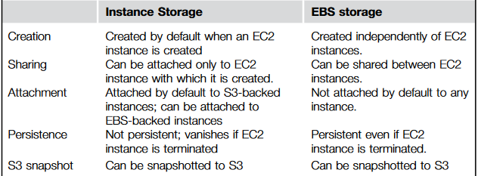
Comparison of Instance Storage and EBS Storage

Slide 37
EC2 Networking Resources
Network resources are also needed by applications in addition to compute and storage resources.
For networking between EC2 instances, EC2 offers both a public address as well as a private address to each instance.
It also offers DNS services for managing DNS names associated with these IP addressees. Amazon Route 53 effectively connects user requests to infrastructure running in AWS – such as Amazon EC2 instances, Elastic Load Balancing load balancers, or Amazon S3 buckets – and can also be used to route users to infrastructure outside of AWS.
Elastic IP address: It is a public IPv4 address, which is reachable from the internet. These addresses are independent of any instance, and can be used to support failover of servers

Slide 38
Virtual Private Cloud
A virtual private cloud (VPC) is a secure, isolated private cloud hosted within a public cloud.
Enterprises that desire more control over their networking configuration can use Virtual Private Cloud (VPC). Examples of VPC are provided below:
The ability to allocate both public and private IP addresses to instances from any address range.
The ability to divide the addresses into subnets and control the routing between subnets.
The ability to connect the EC2 network with an Intranet using a VPN tunnel.

Slide 39
Simple EC2 Example: Setting up a Web Server
The web server will be created as an EBS-backed instance, to avoid the necessity of having to periodically back up the storage to S3.
The process is broken down into four steps:
Selecting the AMI for the instance (Amazon Images” and “Amazon Linux” brings up a list of Linux images supplied by Amazon).
Creating the EC2 instance and installing the web server.
Creating an EBS volume for data, such as HTML files and so on.
Setting up networking and access rules (for allowing external access to the Web server).
Assumptions:
The data needed for the web server (HTML files, scripts, executables, and so on) are available, and have been uploaded to EC2.
The web server needed also has to be uploaded to EC2 and then installed (in reality, a web server instance may be available as an image as well)

Slide 40
Case study of Using Amazon EC2 for Pustak Portal
What is Pustak Portal (a simple book publishing portal): It allows authors to upload and share book chapters or short articles in various formats with readers, who have to be registered with the portal.
Requirements:
It is necessary to store the documents, together with metadata such as the file type, and an access control list of readers who have been given access permission.
As a particular article may become very popular due to its topical nature, the load on the portal could vary greatly, and it is necessary that the number of servers scale up and down with usage.

Slide 41
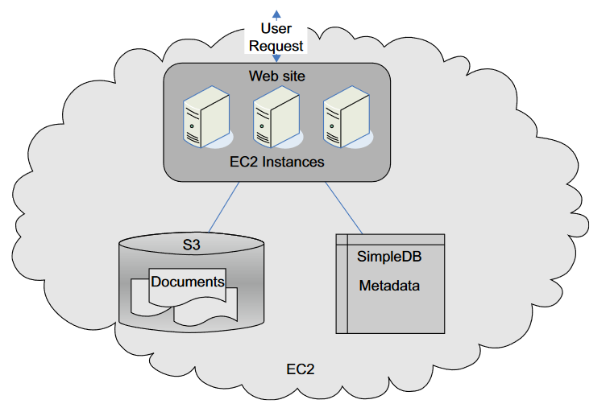
The High-level architecture of the enhanced Pustak Portal

Slide 42


Pustak Portal (Cont…)
Amazon S3 is used for storing articles.
The associated metadata of articles, such as the name of the article, author, and a list of readers, etc., are stored in SimpleDB.

Slide 43
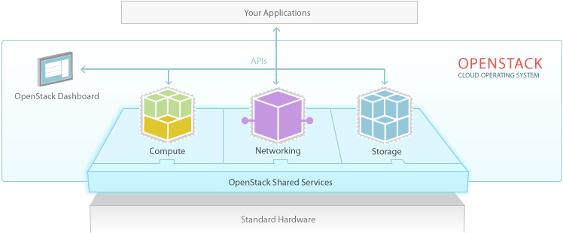
Topic: Openstack
OpenStack is considered as – Infrastructure as a Service (IaaS).
It is a cloud operating system that controls large pools of compute, storage, and networking resources throughout a datacenter, all managed and provisioned through APIs with common authentication mechanisms.
It is one among several open-source cloud building software through which various organizations offer cloud services to their clients.
The cloud can run on the commodity
hardware that are available at economical
costs.

Slide 44
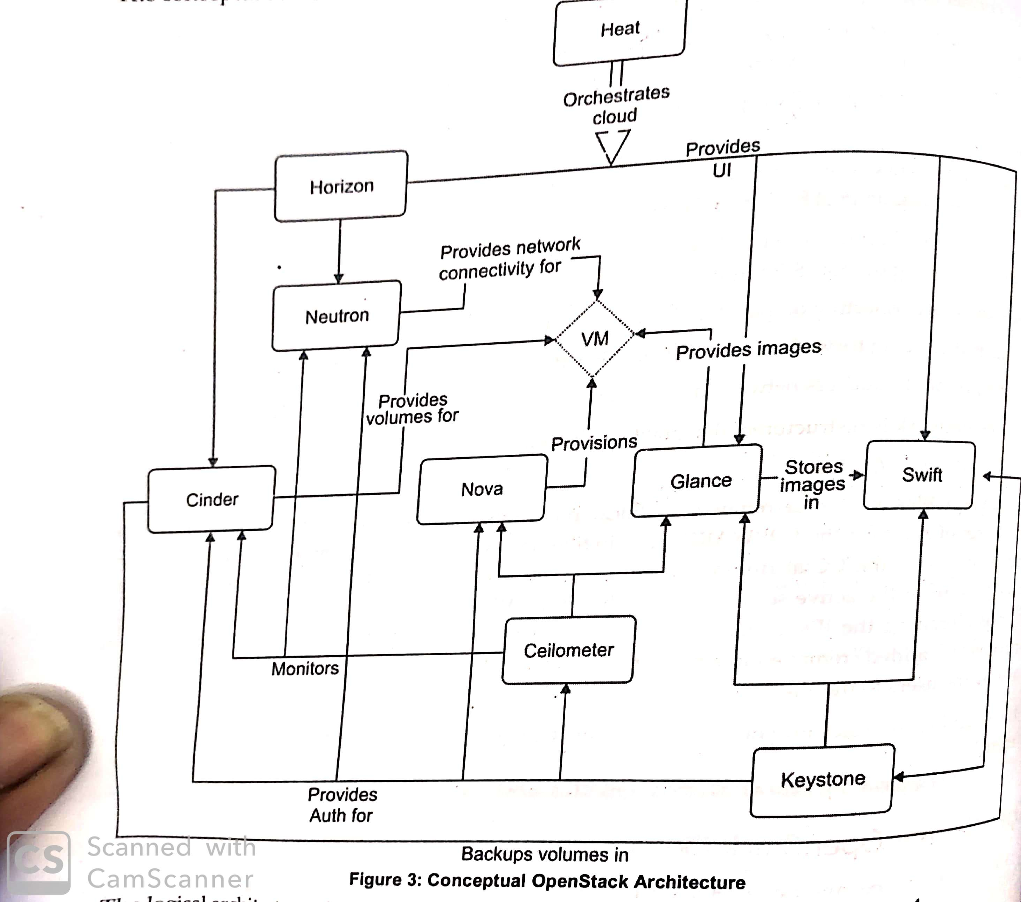
Conceptual OpenStack Architecture

Slide 45
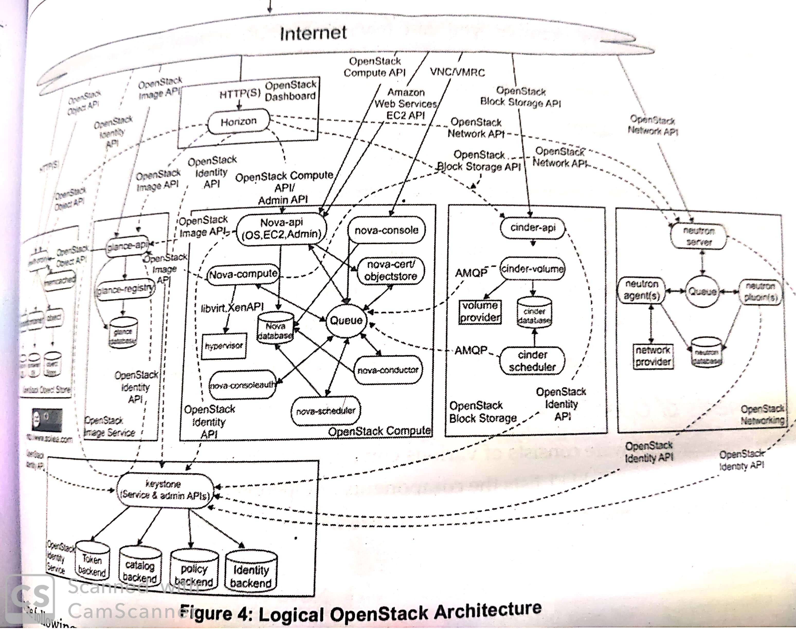
Logical OpenStack Architecture

Slide 46
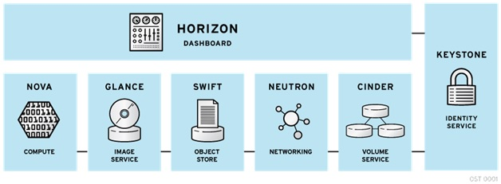
Openstack Key Components

Slide 47
Openstack Components. Cont.
Horizon – Dashboard
It provides a modular web-based user interface for all the OpenStack services. With this web GUI, you can perform most operations on your cloud like launching an instance, assigning IP addresses and setting access controls.
Its primary objective is to interact with the backend API's of other components and execute requests initiated by users.
It interacts with keystone authentication service, to authorize requests before doing anything

Slide 48
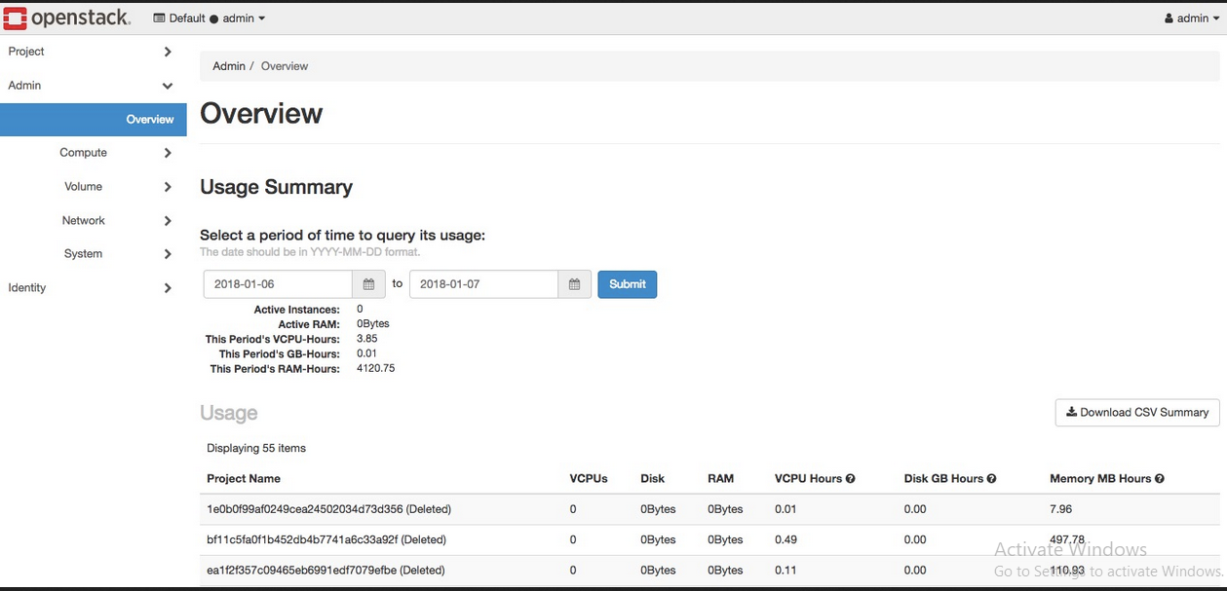
OpenStack
dashboard
Admin tab

Slide 49
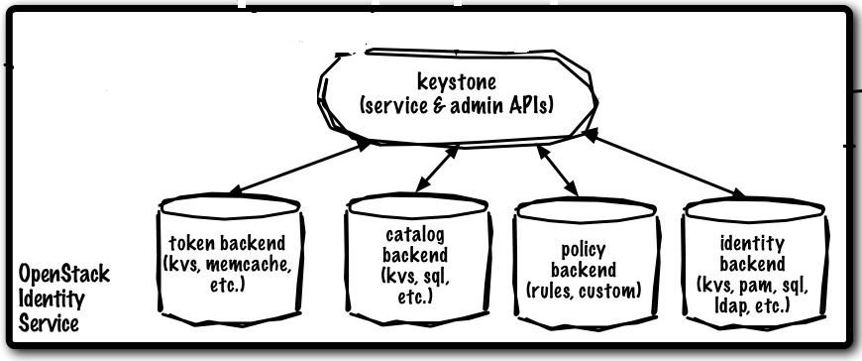
Keystone – Identity
Keystone is a framework for authentication and authorization for all the OpenStack services.
Keystone has two primary functions
1) Manage Users. Like tracking of all users, and their permissions.
2) Service list/catalog. This is nothing but providing information regarding what services are available and their respective API endpoint details.

Slide 50
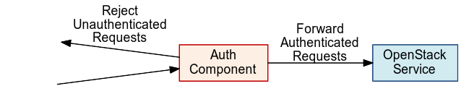
Keystone (OpenStack Identity Service):
The OpenStack Identity Service provides the cloud environment with an authentication and authorization system. In this system, users are a part of one or more projects. In each of these projects, they hold a specific role. Users need to have identity and a particular level of access in the cloud. When a user logs into the cloud, Keystone authenticates that he is indeed a user and authorises his level of access within the cloud.

Slide 51
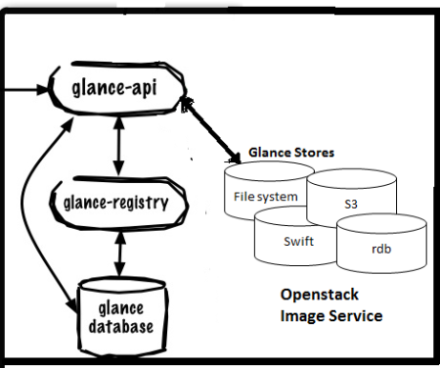
Glance – Image Store
It provides discovery, registration and delivery services for disk and server images. List of processes and their functions:
glance-api : It accepts Image API calls for image discovery, image retrieval and image storage.
glance-registry : it stores, processes and retrieves metadata about images (size, type, etc.).
glance database : A database to
store the image metadata.
A storage repository for the actual
image files. Glance supports
normal file-systems, Amazon S3,
and Swift.

Slide 52
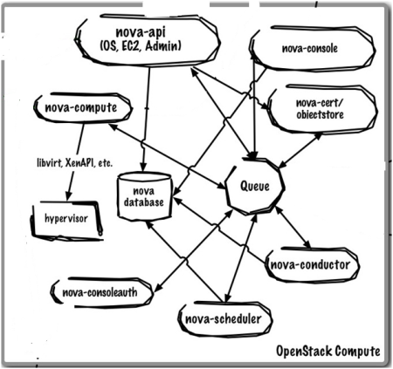
Nova – Compute
It provides virtual servers upon demand. Nova is the most complicated and distributed component of OpenStack. A large number of processes cooperate to turn end user API requests into running virtual machines.

Slide 53
Nova – Compute (Cont…)
nova-api : it’s a RESTful API web service which accepts incoming commands to interact with the OpenStack cloud.
nova-compute: it’s a worker daemon which creates and terminates virtual machine instances via Hypervisor’s APIs .
nova-scheduler: it takes a request from the queue and determines which compute server host it should run on.
nova-conductor: It provides services for nova-compute, such as completing database updates and handling long-running tasks.

Slide 54
Nova – Compute (Cont…)
nova database: It stores most of the build-time and run-time state for a cloud infrastructure.
The queue provides a central hub for passing messages between daemons. This is usually implemented with RabbitMQ.
Nova also provides console services to allow end users to access their virtual instance’s console through a proxy. This involves several daemons (nova-console, nova-novncproxy and nova-consoleauth).

Slide 55
Nova – Compute (Cont…)
nova-network : it’s a worker daemon very similar to nova-compute. It accepts networking tasks from the queue and then performs tasks to manipulate the network (such as setting up bridging interfaces or changing iptables rules). This functionality is being migrated to Quantum, a separate OpenStack service.
nova-volume : Manages creation, attaching and detaching of persistent volumes to compute instances. This functionality is being migrated to Cinder, a separate OpenStack service.

Slide 56
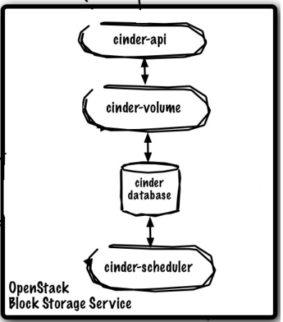
Cinder – Block Storage
Cinder allows block devices to be exposed and connected to compute instances for expanded storage & better performance.

Slide 57
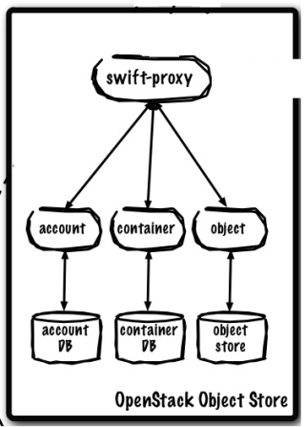
Swift – Object Storage
Object store allows you to store or retrieve files. It provides a fully distributed, API-accessible storage platform that can be integrated directly into applications or used for backup, archiving and data retention.
Note : Object Storage is not a traditional file system, but rather a distributed storage system for static data such as virtual machine images, photo storage, email storage, backups and archives.

Slide 58
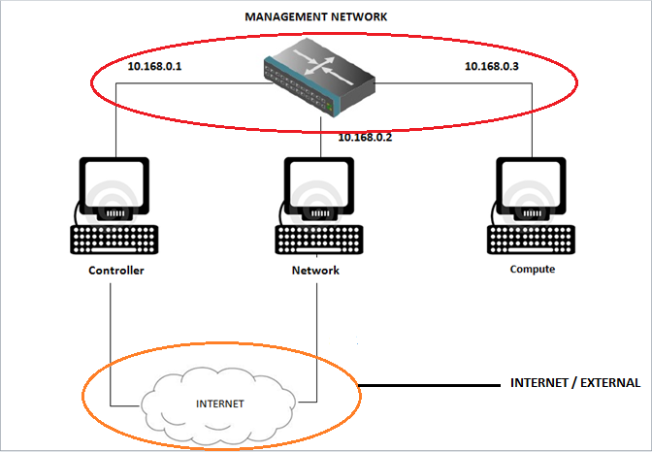
Networking
There are two networks :
Internal or Management network
External or
Internet
network

Slide 59
INTERNAL / MANAGEMENT NETWORK: → This network is present for internal connection between the machines. → The IP addresses for the network must be reachable only by the admin.
2. INTERNET / EXTERNAL NETWORK : → provides the VMs with internet access in some scenarios. → The IP addresses are reachable by anyone on the internet.
Note the IP addresses of the two networks. They are different.
The networks must be different from each other.
They are isolated from one another.

Slide 60
CONTROLLER NODE
- The controller is the central management system in a multinode cloud installation.
The Controller node supplies API, scheduling, and other shared services for the cloud.
The Controller node has the dashboard, the image store, and the identity service. Additionally, Nova compute management service as well as the Neutron server are also configured in this node.

Slide 61
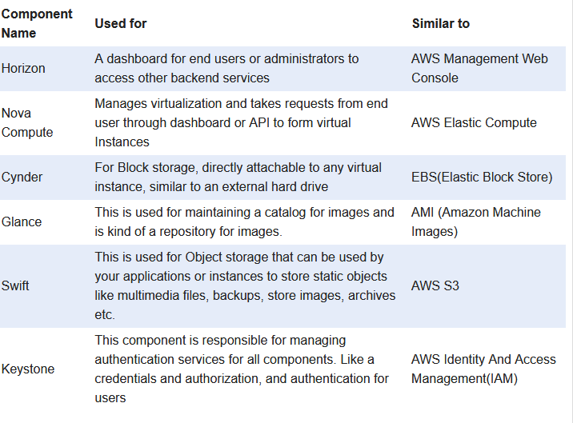

Slide 62
OpenStack Installation References (Taxila)
https://youtu.be/x5tuyzwq16k?list=PLvvQ7qimTOkmJFGS_uYlOA423PlvVmxOg (Installation)
https://youtu.be/wzVSGGg4fsY?list=PLvvQ7qimTOkmJFGS_uYlOA423PlvVmxOg (Instance Creation)
https://youtu.be/G1ZY4RorBiw?list=PLvvQ7qimTOkmJFGS_uYlOA423PlvVmxOg (Instance Creation with Volume)
https://youtu.be/QFkfSgjJddI?list=PLvvQ7qimTOkmJFGS_uYlOA423PlvVmxOg (Swift Object Storage)
Cloud Computing Black Book, Kailash Jaiswal, etc., 2020 Edition.

Slide 63
Topic: Managing Virtual Resources on the Cloud: Provisioning and Migration
Public cloud: Public cloud or external cloud describes cloud computing in a traditional mainstream sense, whereby resources are dynamically provisioned via publicly accessible Web applications/Web services (SOAP or RESTful interfaces) from an off-site third-party provider, who shares resources and bills on a fine-grained utility computing basis, the user pays only for the capacity of the provisioned resources at a particular time.
There are many examples for vendors who publicly provide infrastructure as a service. Amazon Elastic Compute Cloud (EC2) is the best known example. Few other examples GoGrid, JoyentAccelerator, Rackspace, AppNexus, FlexiScale, and ManjrasoftAneka.

Slide 64
Topic: Managing Virtual Resources on the Cloud: Provisioning and Migration (Cont…)
Private Cloud: A private cloud aims at providing public cloud functionality, but on private resources, while maintaining control over an organization’s data and resources to meet security and governance’s requirements in an organization. Private cloud exhibits a highly virtualized cloud data center located inside your organization’s firewall.
- The best-known examples are Eucalyptus and OpenNebula.
High Availability: It allows virtual machines to automatically be restarted in case of an underlying hardware failure or individual VM failure.
- If one of your servers fails, the VMs will be restarted on other virtualized servers in the resource pool, restoring the essential services with minimal service interruption.

Slide 65
Two core services of getting resources for VMs
In Infrastructure as a Service (IaaS), the provisioning of required resources for systems and applications on a large number of physical machines is traditionally a time-consuming process with low assurance on deployment’s time and cost.
Two core services are there that enable the users to get the best out of the IaaS model in public and private cloud setups.
Virtual machine provisioning and
Migration services

Slide 66
Why Virtual Machine Provisioning is required?
To provide a new virtual machine in a matter of minutes, saving lots of time and effort.
Generic procedure for virtual machine provisioning:
-Check the inventory for a new machine, get one, format, install OS required, and install services; a server is needed along with lots of security batches and appliances.
With the emergence of virtualization technology, it is just a matter of minutes to achieve the above task of IT admin through public cloud virtualization management software package or a private cloud management solution installed at your data center in order to provision the virtual machine inside the organization and within the private cloud setup.

Slide 67
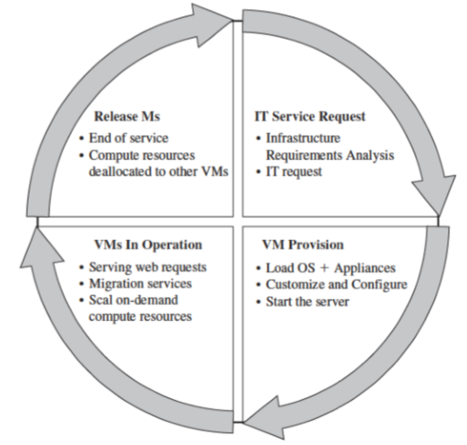
Virtual Machine Provisioning and Manageability Life Cycle
• The cycle starts by a request delivered to the IT department, stating the requirement for creating a new server for a particular service.
• This request is being processed by the IT administration to start seeing the servers’ resource pool, matching these resources with requirements
Starting the provision of the needed virtual machine.
• Once it provisioned and started, it is ready to provide the required service according to an SLA(Service Level agreement ).
• Virtual is being released; and free resources.
Virtual Machine Life Cycle

Slide 68
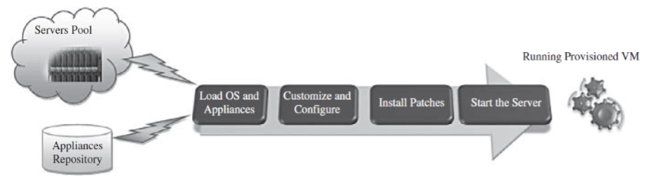
VM Provisioning Process
Steps to Provision VM -
Select a server from a pool of available servers along with the appropriate OS template you need to provision the virtual machine.
• Load the appropriate software (operating system, device drivers, middleware, and the needed applications for the service ), .
Customize and configure the machine (e.g., IP address, Gateway) to an associated network and storage resources.
• Finally, the virtual server is ready to start with its newly loaded S/W.

Slide 69
VM Provisioning using templates
• Provisioning from a template reduces the time required to create a
new virtual machine.
• Administrators can create different templates for different purposes.
For example –
Vagrant provision tool using VagrantFile (template file) (demo)
Heat – Orchestration Tool of openstack (Heat template in YAML format)
(demo – Instance creation in cloud, Load balancer in cloud)
This enables the administrator to quickly provision a correctly configured virtual server on demand.

Slide 70
Why Migration is required?
Migrations of a virtual machine is a matter of milliseconds: saving time, effort, making the service alive for customers, and achieving the SLA/SLO agreements and quality-of-service (QoS) specifications required.
A particular VM is consuming more than its fair share of resources at the expense of other VMs on the same host, it will be eligible, for this machine, to either be moved to another underutilized host or assign more resources for it.

Slide 71
Virtual Machine Migration Services
Virtual Machine Migration Services
Migration service -
The process of moving a virtual machine from one host server or storage location to another. It plays an important role in datacenters by making it easy to adjust resource’s priorities to match resource’s demand conditions.
There are different techniques of VM migration-
Cold/regular migration,
Hot/live migration, and
- Live storage migration of a virtual machine.
In this process, all key machines’ components, such as CPU, storage disks, networking, and memory, are completely virtualized, thereby facilitating the entire state of a virtual machine to be captured by a set of easily moved data ﬁles.
Notes:
RL 3.5

Slide 72
Cold/regular migration
Cold migration is the migration of a powered-off virtual machine and is done in the following tasks:
If the option to move to a different datastore was chosen, the configuration files, including the NVRAM file (BIOS settings), and log files are moved from the source host to the destination host’s associated storage area. If you chose to move the virtual machine's disks, these are also moved.
The virtual machine is registered with the new host.
After the migration is completed, the old version of the virtual machine is deleted from the source host if the option to move to a different datastore was chosen.

Slide 73
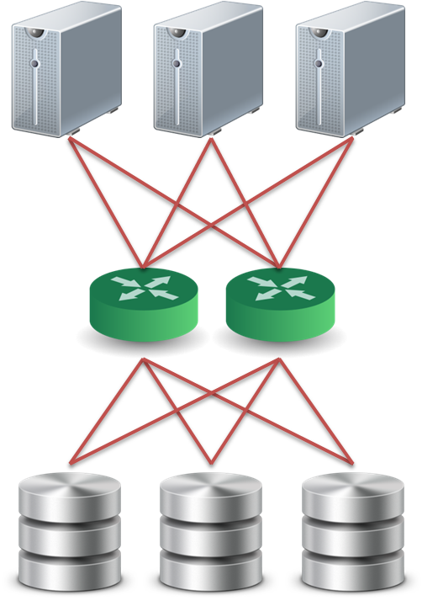
Live Migration Technique (hot or real-time migration)
It can be defined as the movement of a virtual machine from one physical host to another while being powered on. When it is properly carried out, this process takes place without any noticeable effect
from the end user’s point of view (a matter of milliseconds). Live migration can also be used for load balancing.
Pre-assumption :
We assume that all storage resources are separated from computing resources.
Storage devices of VMs are attached from network :
NAS: NFS, CIFS
SAN: Fibre Channel
iSCSI, network block device
drdb network RAID
Require high quality network connection
Common L2 network (LAN)
L3 re-routing
VM 1
VM 2
VM 2
Disk
VM 1
Disk

Slide 74
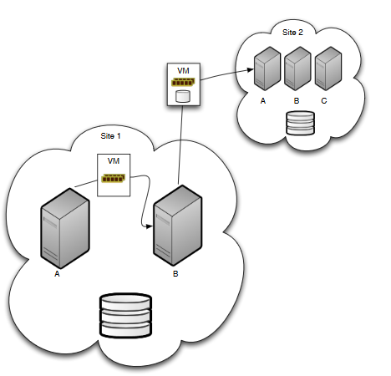
In-site and Cross-site Migration

Slide 75
Live Migration Technique
Challenges of live migration :
VMs have lots of state in memory
Some VMs have soft real-time requirements :
For examples, web servers, databases and game servers, ...etc.
Need to minimize down-time
Relocation strategy :
Pre-migration process
Reservation process
Iterative pre-copy
Stop and copy
Commitment
Reference (complete information of Live Migration) http://www.diva-portal.org/smash/get/diva2:707793/FULLTEXT02

Slide 76
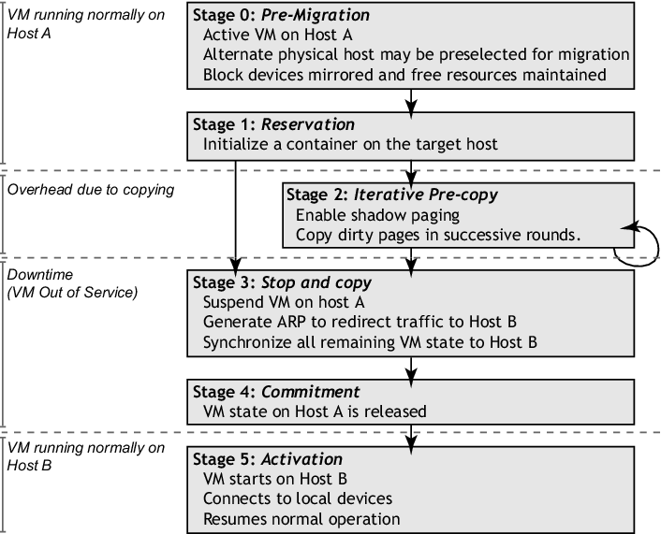
Live Migration Technique
Note: We can migrate but with Short downtime.

Slide 77

Live Migration Technique
Pre-migration process
Reservation process
VM active on host A
Destination host selected (Block devices mirrored)
Initialize container on target host
Copy dirty pages in successive rounds
Suspend VM on host A
Redirect network traffic
Synch remaining state
Activate on host B
VM state on host A released
Iterative pre-copy
Stop and copy
Commitment

Slide 78
Live Migration Technique
Live migration process :
Pre-copy migration : Round 1,
Enable Shadow Paging
Host A
Host B

Slide 79
Live Migration Technique
Live migration process :
Pre-copy migration : Round 2
Host A
Host B

Slide 80
Live Migration Technique
Live migration process :
Stop and copy : Final Round
Host A
Host B

Slide 81
Live Storage Migration of Virtual Machine.
This migration technique constitutes moving the virtual disks or configuration file of a running virtual machine to a new data store without any interruption in the availability of the virtual machine’s service.
Refererences: https://docs.microsoft.com/en-us/previous-versions/windows/it-pro/windows-server-2012-r2-and-2012/hh831656(v=ws.11)
https://ieeexplore.ieee.org/stamp/stamp.jsp?tp=&arnumber=5071905 (A Live Storage Migration Mechanism over WAN for Relocatable Virtual Machine Services on Clouds)

